Slide 1

CAPSTONE PROJECT
EMPLOYEE SALARY PREDICTION
Presented By:
Name of student - Nithyashree.V
College Name- Rajalakshmi Institute of technology
Department - Computer science and Engineering

Slide 2
OUTLINE
Problem Statement (Should not include solution)
System Development Approach (Technology Used)
Algorithm & Deployment (Step by Step Procedure)
Result
Conclusion
Future Scope(Optonal)
References

Slide 3
Problem Statement
Mention what your project is all about min 5 line
This project involves applying machine Learning models to predict whether an individual earns more than or less than 50K annually, based on features like age, education, occupation, etc., using the 'adult.csv' dataset from the edunet organization. The goal is to analyze income classification . Here I have used logistic regression ml model

Slide 4
System Approach
Collected data from the "adult.csv" dataset
Preprocessed the data (cleaning, encoding categorical values)
Split the dataset into training and testing sets
Applied machine learning models (Logistic Regression)
Evaluated models using accuracy and classification metrics
System requirements and libraries used
Software Requirements: Platform: Google Colab / Jupyter notebook
Libraries Used
pandas – for data manipulation
numpy – for numerical operation
matplotlib, seaborn – for data visualization
sklearn – or machine learning models and evaluation

Slide 5
Algorithm & Deployment
1. Load Dataset – Import the adult.csv dataset.
2. Preprocess Data – Handle missing values and encode categorical variables
3. Split Data – Divide data into training and testing sets and proceed
4. Train Model – Use a machine learning model(ex.logistic regression)
5. Evaluate Model – Measure accuracy and other metrics using test data.
6. Visualize Results – Plot graphs for better understanding and insight.
7. Make Predictions – Predict whether income >50K or ≤50K.
Deployment
The project was implemented using Google Colab.
Dataset was uploaded directly from the device.
Model training, evaluation, and visualizations were done entirely in Colab.
The output and workflow were recorded for demonstration purposes

Slide 6
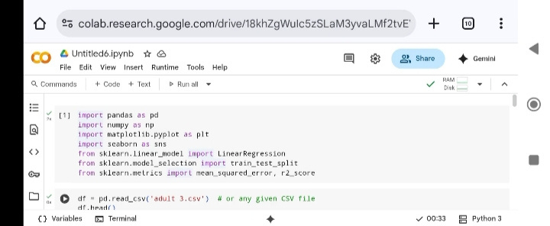
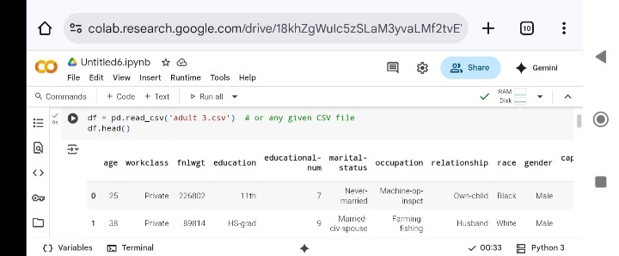
Importing Libraries and loading the dataset
Result

Slide 7
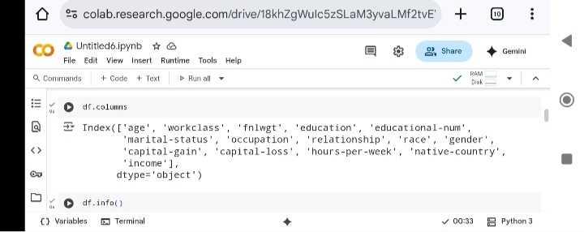
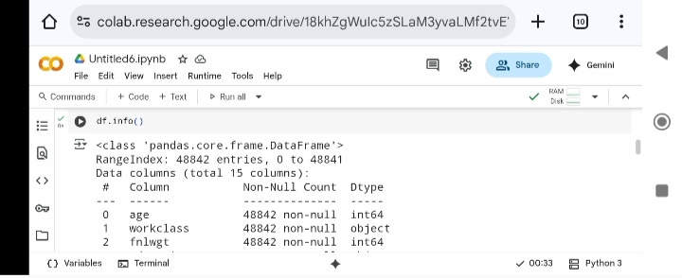
checking coloumns and information

Slide 8
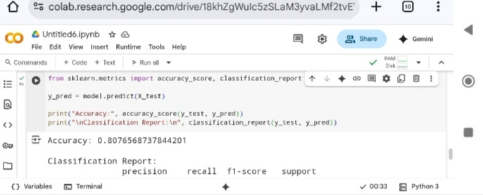
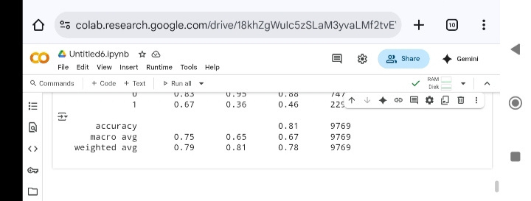

Slide 9
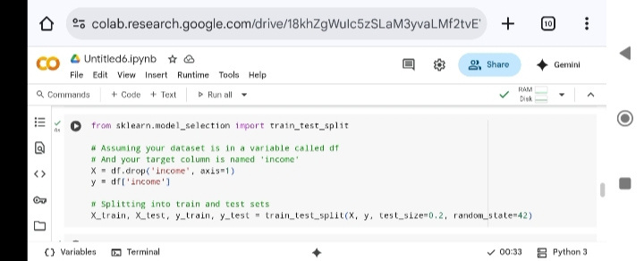
Splitting the dataset into training and testing models

Slide 10
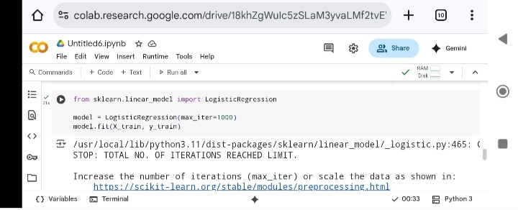

Slide 11
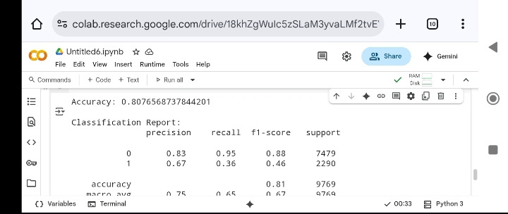
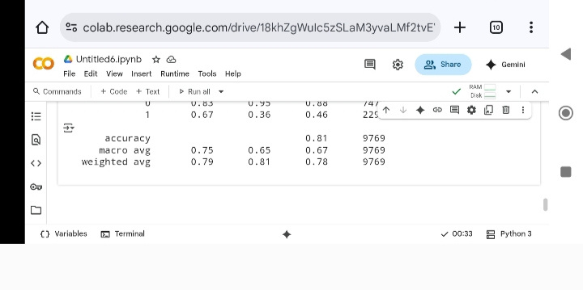
﻿End of coding

Slide 12
Conclusion
Findings Effectiveness : The mode successfully predicted whether an individual earns more than 50k based on various demographic features logistic regression gave decent accuracy and and was easy to implement and intrepret
Challenges faced : Dataset had missing values and inconsistent formats which required preprocessing
Enocding categorical variables was crucial to avoid model errors
Conclusion : This project offered practical experience in applying machine learning to a real-world classification problem using the Adult Income dataset. It enhanced our understanding of data preprocessing, model building, and evaluation. The solution was effective and insightful, demonstrating the potential of ML in social and economic predictions

Slide 13
Future scope(Optional)
1.Improve data accuracy using advanced models (e.g., Random Forest, XGBoost).
2.Automate data processing and streamline model updates.
3.Deploy model using cloud services or a simple web app.
4.Add interpretability tools (like SHAP) for better transparency.
5.Ensure scalability, security, and ethical data handling.

Slide 14
References
1. UCI Machine Learning Repository – Adult Dataset
🔗 https://archive.ics.uci.edu/ml/datasets/adult
2. Scikit-learn Documentation – For model building and evaluation
🔗 https://scikit-learn.org/stable/documentation.html
3. Towards Data Science Articles – Simplified ML tutorials and use-cases
🔗 https://towardsdatascience.com
4. Kaggle Discussions and Notebooks – Sample EDA and model comparisons
🔗 https://www.kaggle.com/uciml/adult-census-income
5. "A survey of classification techniques in data mining" – Research paper overviewing algorithms like Logistic Regression, Decision Trees, etc.
🔗 [ResearchGate / Google Scholar]
6. Medium: Machine Learning with Python – Articles on data preprocessing and model tuning
🔗 https://medium.com/tag/machine-learning

Slide 15
THANK YOU

